Slide 1
Final Project : Survival
Nehemiah Cedillo

Slide 2
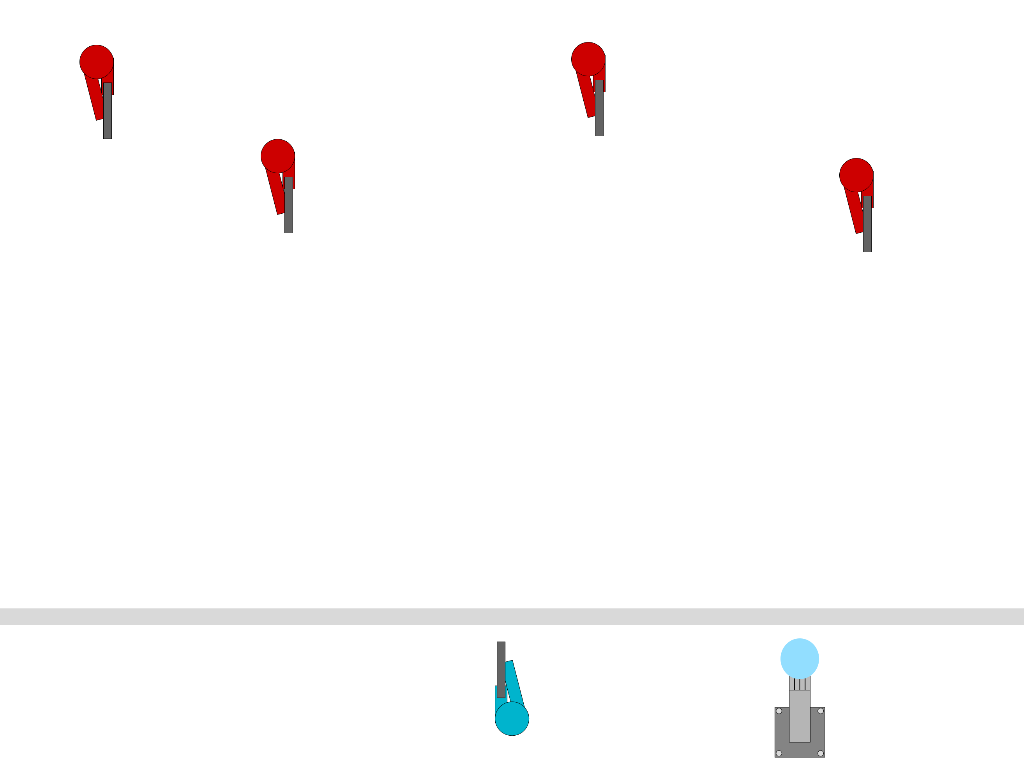
Game Idea : Surviving Against Enemies
Goal:
Survive against a wave of enemies.
Infinitely spawning enemies
Try to gain a high score.
How: Player Shoots at the Enemies
References:
Similar to Call Of Duty 3 Spec Ops Survival.

Slide 3
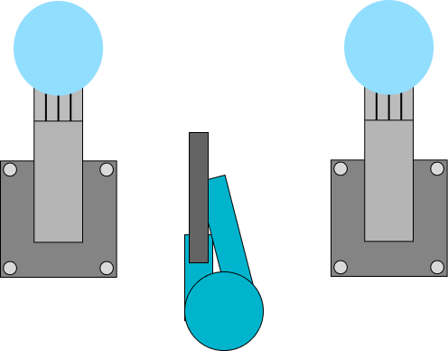
Replay-ability : High Score
While playing the game, the player will be scored in a 2 of ways:
Number of Enemies Destroyed.
Amount of Time Survived
After the player is defeated, they will be given their final score.

Slide 4
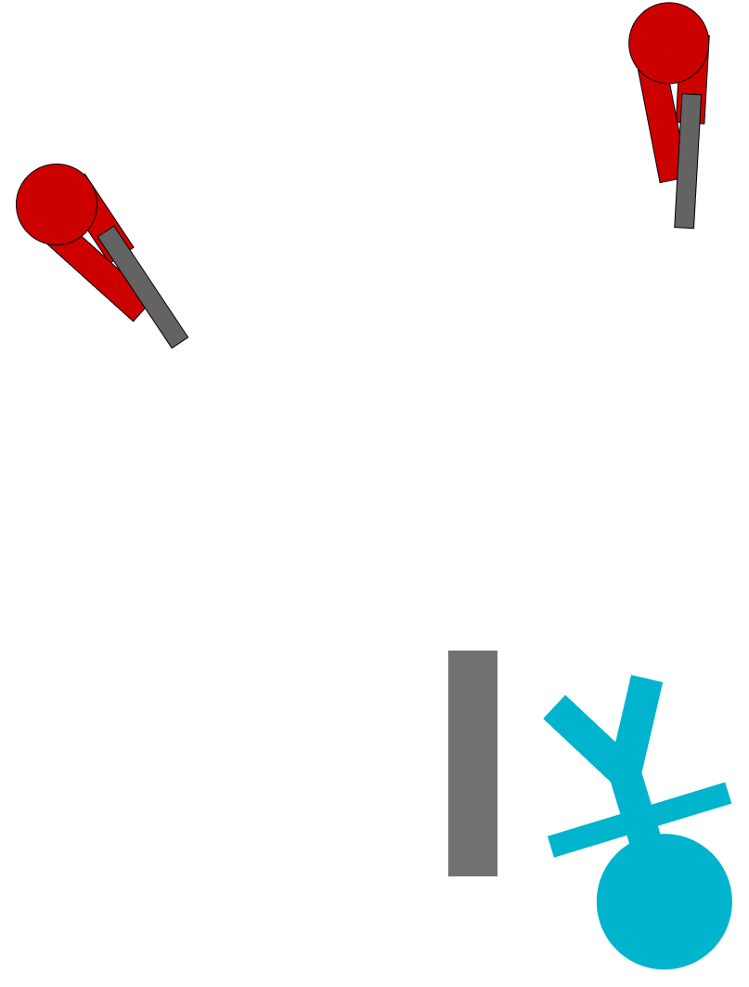
Win / Lose
No Real Win State
Game will only end when the player is defeated.
Player can continue destroying enemies by:
Buying Upgrades
Buying Additional Items:
Grenades
Sentries
Repairing the barricade.

Slide 5
Current Plan for Project

Slide 6
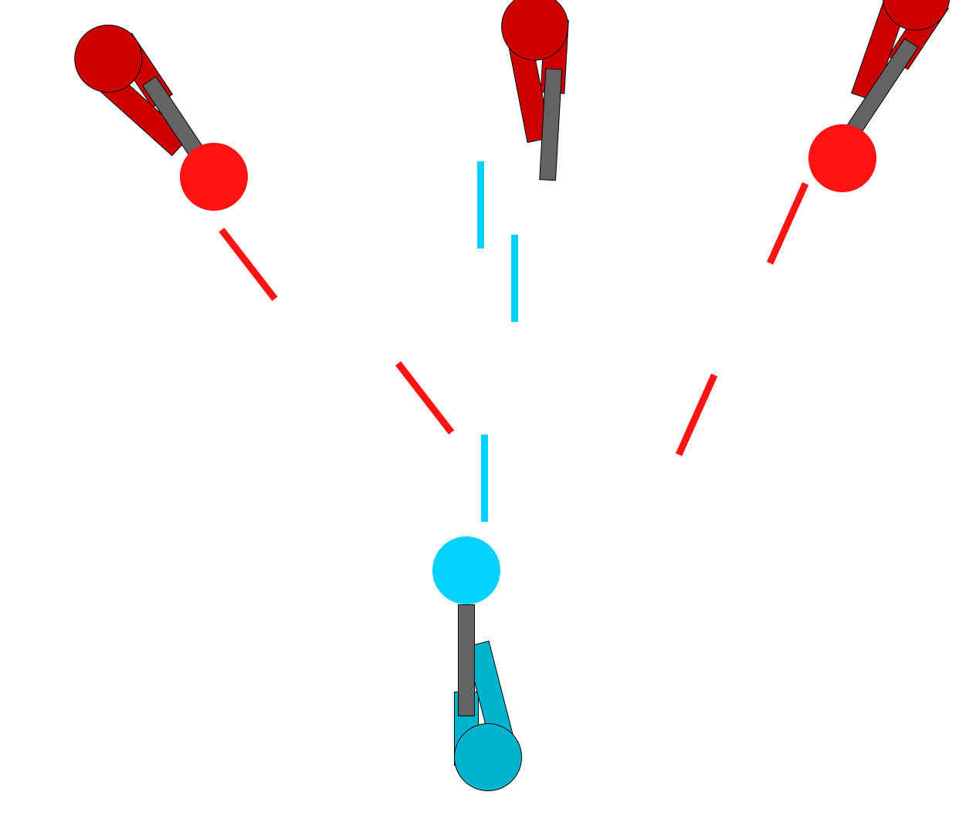
Main Mechanic : Enemies Approaching
Enemies Approach the barricade.
Once within range, they’ll start to shoot at the barricade.
Once the barricade is destroyed, they will shoot at the player.

Slide 7
Coding Plan : Player
Player can:
Move left or Right
Point and shoot enemies with the mouse.
If enough time:
Place down sentries
Repair the Barricade
Able to get currency for each type of enemy destroyed.

Slide 8
Coding Plan : Enemies
Enemies will have a:
Speed
Health Pool
Fire rate
States:
Approaching
Attacking
If Barricade exists, shoot the barricade
Else shoot at player
Will change angles to face target

Slide 9
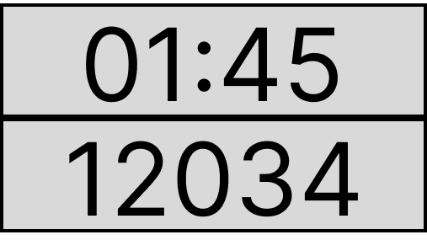
Scoreboard
Scoreboard will keep track of:
Time
Enemies destroyed.
Overall Score

Slide 10
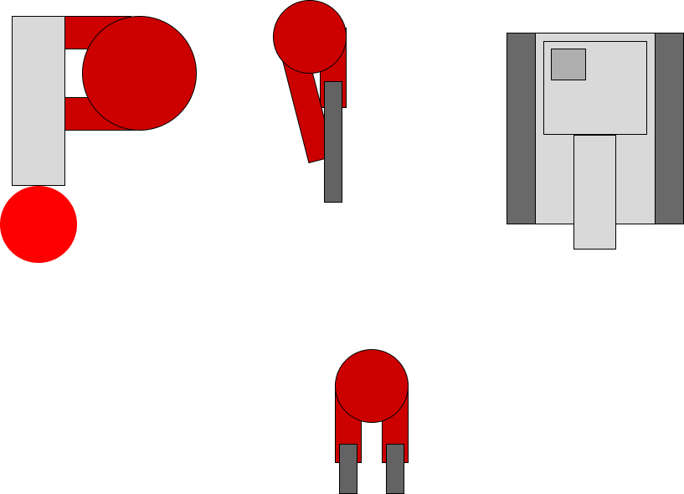
Other Mechanics to Add if Possible
Upgrade the player’s weapon.
Adding Sentries
Furthermore, adding a variety of sentries.
Repair the barricade.
Different Enemy Types.
Slow Moving, but tougher enemies
Teleporting Enemies
Tanks / Vehicles.

